Slide 1

DAY 3
HANDS - ON

Slide 2

Cohere
CHATBOT

Slide 3
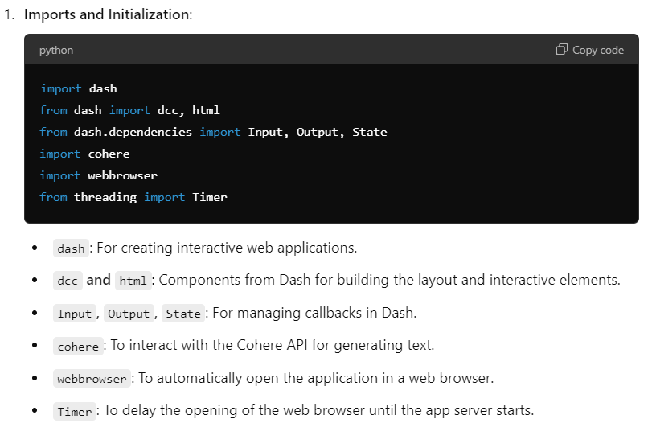
COHERE CHATBOT

Slide 4
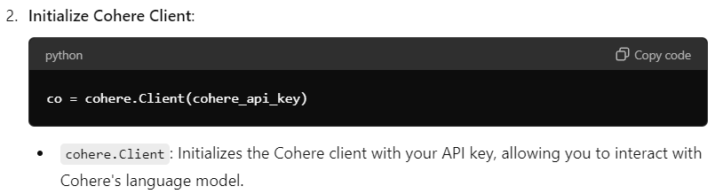
COHERE CHATBOT

Slide 5
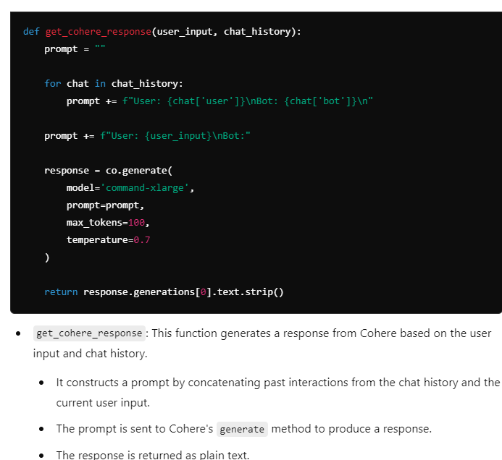
COHERE CHATBOT

